Slide 1
Chapter 12. Data Mining Trends and Research Frontiers
Mining Rich Data Types
Data Mining Applications
Data Mining Methodologies and Systems
Data Mining, People and Society
Summary
Notes:
1

Slide 2
Mining Rich Data Types
Mining Text Data
Mining Spatial-Temporal Data
Mining Graph and Networks
Notes:
2

Slide 3
Mining Text Data
Over 80% of the data is in an unstructured format, e.g., news, image, audio.
Goal: deriving high-quality information, such as structures, patterns, and summaries, from unstructured text data.
Process: mining structures from text ⇒ deriving patterns within the structured data ⇒ evaluating and interpreting output
Main challenge:
How to represent text primitives (e.g., words, sentences, and documents) and how to learn effective representation from unstructured text?
Notes:
3

Slide 4
Mining Text Data: Major Tasks
Information extraction (IE): automatically extracting structured information from unstructured and semi-structured documents.
Taxonomy construction: constructing different multi-faceted taxonomies based on different corpora or applications.
Text clustering: grouping unlabeled texts with similar contextual patterns.
Text classification: analyzing open-ended texts (e.g., webpages) and
assigning them a set of predefined topics or categories
Text summarization: creating a subset of text that represents the most important information from a single or multiple pieces of text.
Notes:
4

Slide 5
Mining Text Data: Techniques
Symbol-based representation: using one-hot vectors for words and bag-of-words model for documents.
Issues: high-dimensionality and data sparsity
Distributed representation: low-dimensional real-valued dense vectors with large amount of unlabeled data using deep neural network.
Word embedding: words similar in meaning are expected to be closer in the embedded space.
Pre-trained language model: using large-scale data and more computing resources to generate contextualized embeddings.
Notes:
5

Slide 6
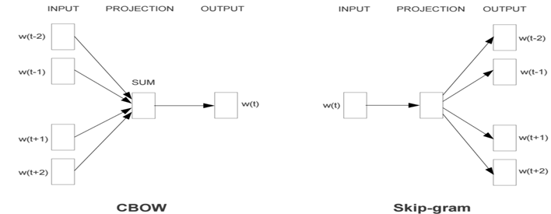
Mining Text Data: Techniques
Word2vec: words that share common contexts are embedded in close proximity, e.g., “Sweden" can be embedded close to Norway, Finland.
CBOW: predicts the current word from surrounding context words.
Skip-gram: uses the current word to predict the surrounding words.
GloVe: combining global matrix factorization
and local context window methods.
JoSE: learning word embeddings in hyperbolic
space to model hierarchical structures.
Pre-trained language model: ELMo and BERT
Notes:
6

Slide 7
Mining Rich Data Types
Mining Text Data
Mining Spatial-Temporal Data
Mining Graph and Networks
Notes:
7

Slide 8
Mining Spatial-Temporal Data: Properties and Types
Key Properties in Spatial and Temporal Data
Auto-correlation: dependencies and correlations in proximate locations and time, e.g., similar traffic status for adjacent intersections.
Heterogeneity: heterogeneous and non-stationary in distribution.
Types of Spatial and Temporal Data
Data type | Definition | Operation | Examples
Event | at a spatial location and a time point | intersections and similarity/difference | intersection of forest fire and a rainfall returns the overlapping area and time
Trajectory | a path of an object over space and time | finding relationships between two trajectories | transportation (e.g., tracing vehicle), epidemiology, ecology
Point reference data | collected using discrete reference points | reconstructing fields and modeling non-stationary random process | using mobile sensors to collect temperature data in a certain region
Raster data | recording observation data at fixed locations and fixed time | converting a raster to a finer or coarser resolution | estimate traffic volume using data from nearby sensors/cameras
Notes:
8

Slide 9
Mining Spatial-Temporal Data: Data Models
Data Models for Spatial Data
Object model: points, lines, polygons (e.g., point ⇒ vehicle, line ⇒ road)
Field model: spatial information as a function (e.g., temperature in an area)
Spatial network model: graphs for relationship (e.g., road network)
Data Models for Temporal Data
Temporal snapshot model: multiple spatial layers associated with time.
Temporal change model: a spatial theme using a start time and the incremental changes (e.g., moving of a vehicle with initial location, speed)
Event/process model: multiple events and processes over time
Notes:
9

Slide 10
Mining Rich Data Types
Mining Text Data
Mining Spatial-Temporal Data
Mining Graph and Networks
Notes:
10

Slide 11
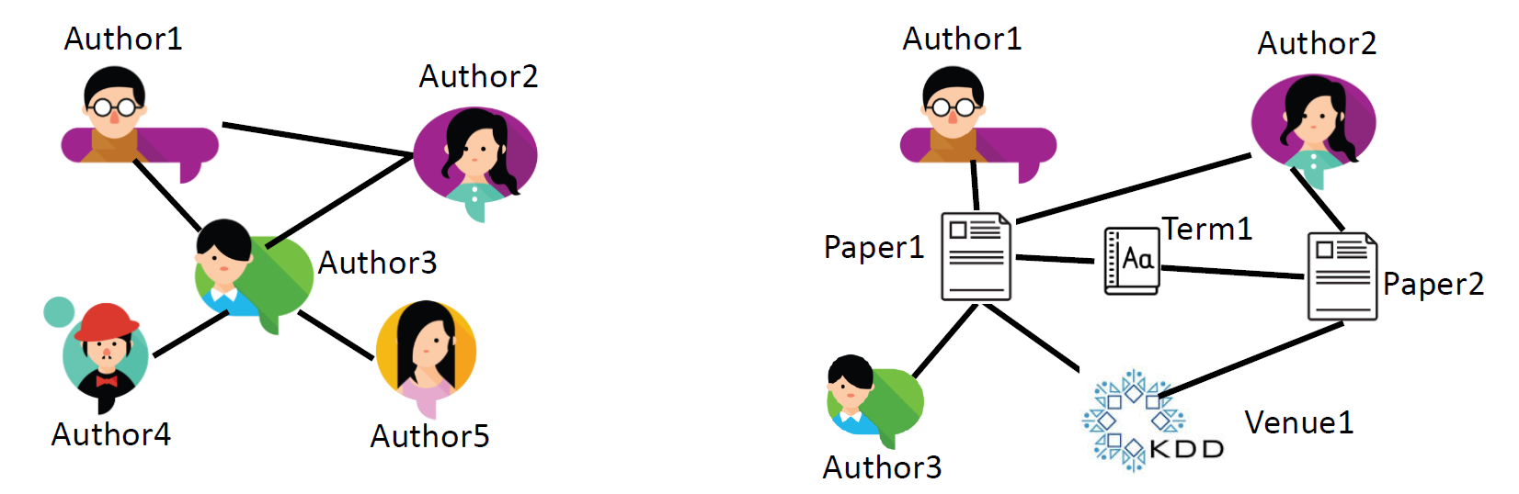
Mining Graph and Networks
Graph/Networks: consist of (1) a set of nodes and (2) a collection of edges, to model complex systems, e.g., online social platform
Categorization
attributed vs. plain graphs:
node/edge attributes exist or not.
dynamic vs. static graphs:
graph topology/attribute change or not.
homogeneous vs. heterogeneous graphs:
nodes/edges are of the same type or not.
Homogeneous vs. heterogeneous networks
Notes:
11

Slide 12
Mining Graph and Networks: Problems
Graph Modeling: to study and simulate the generation mechanisms.
Motivation: (1) understanding how graphs are created and formed, (2) helping protect user privacy by anonymizing social networks.
Graph models:
Erdős–Rényi model: assumes certain probability distributions.
realistic graph generators: mimic one or more properties of real-world graphs, e.g., preferential attachment based (Barabási–Albert model).
deep generative models: mimic the real graphs with neural networks.
Challenge: heterogeneous networks
Notes:
12

Slide 13
Mining Graph and Networks: Problems
Heterogeneous Network Mining: capturing rich semantics
Core concept: meta-path represents a sequence of relations, e.g., author-paper-author ⇒ co-authorship relation.
Applications of meta-path
Similarity search: improving ranking accuracy
Node classification: similarity matrices can be used to infer node labels
Clustering: representing different semantics
heterogeneous network embedding: constructing neighborhood
Challenge: automatically inferring structure and semantics from input data
Notes:
13

Slide 14
Mining Graph and Networks: Problems
Knowledge Graph Mining
Knowledge graph (KG): a directed heterogeneous graph to link concepts and entities through human-interpretable semantics, e.g., DBPedia, Google KG.
KG construction methods: labor intensive, relying on pre-specified ontology
Extractive construction: information extraction, e.g., semantic labeling.
Language model-based
Representation learning-based: link prediction, entity resolution
Challenges: (1) automatic knowledge graph construction and dynamic update, (2) medical AI, conversational AI, and academic search engine
Notes:
14

Slide 15
Summary: Mining Rich Data Types
Mining Text Data
Major tasks: information extraction, taxonomy construction, text clustering/classification/summarization
Techniques: symbol-based and distributed representation (e.g., word2vec)
Mining Spatial-Temporal Data
Types: event, trajectory, point reference data, raster data
Models: object/field/spatial network and snapshot/change/event-process
Mining Graph and Networks
Problems: graph modeling, heterogeneous graph mining, knowledge graph

Slide 16
Chapter 12. Data Mining Trends and Research Frontiers
Mining Rich Data Types
Data Mining Applications
Data Mining Methodologies and Systems
Data Mining, People and Society
Summary
Notes:
16

Slide 17
Data Mining Applications
Data Mining for Sentiment and Opinion
Truth Discovery and Misinformation Identification
Information and Disease Propagation
Productivity and Team Science

Slide 18
Sentiment and Opinion
Sentiment: a view of attitude/emotion toward a situation or event.
Opinion: a view or judgement formed about something.
Sentiment and opinion are heavily correlated.
Note: many opinions may express sentiment, but some do not. (e.g., “I think she will move to Canada after graduation.”)
Subtle difference between sentiment and opinion:
Sentiment sentence example: “I find data mining highly interesting.”
Opinion sentence example: “I believe data mining is promising and useful.”
The subtle difference is that one may share the same sentiment expressed in the example of sentiment sentence and agree or disagree with the opinion in the second sentence.

Slide 19
Sentiment Analysis and Opinion Mining Techniques
Goal: understand sentiment expressed in text.
Techniques being used:
Natural language processing methods.
Machine learning and data mining methods.
Psychology and social sciences.
Technical directions being explored:
Analysis at different levels: Document-level, sentence-level, aspect-level.
Sentiment classification based on lexicons.
Two types of text content: stand-alone and online conversations.
Mining intent: intent may imply sentiments and express opinions.
Opinions spam detection: acquire data for social goodness.

Slide 20
Sentiment Analysis and Opinion Mining Applications
Understand advantages/disadvantages of targets:
Sentiment analysis/opinion mining over product reviews.
Help customer make decisions; Help platform optimize supply chain; Help producers and manufacturers improve products, etc.
Outcome can be consumed by other AI agents:
Example: sentiment from news trading signals for stock markets.
Challenges: highly efficient/accurate/robust system.
Monitoring and government administration:
Fight against cyber-violence, terrorism and racism.
Challenges: fairness and privacy issues.

Slide 21
Data Mining Applications
Data Mining for Sentiment and Opinion
Truth Discovery and Misinformation Identification
Information and Disease Propagation
Productivity and Team Science

Slide 22
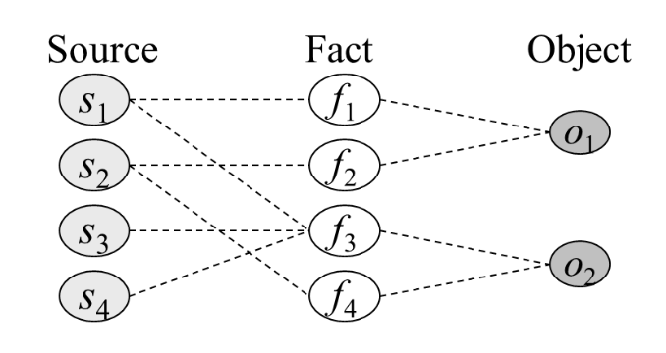
Truth Discovery
Goal: assess and choose the actual true value for a data item when different sources provide conflicting information on it.
Single-truth discovery:
Only one true value is allowed for data item.
Multi-truth discovery:
Multiple true values are allowed for data items.
Challenges:
Source trustworthiness and claim reliability.
Limited amount of labeled data source: semi-supervised/unsupervised.
Detect copy behaviors of false values.
Evaluation: based on data distribution and treat those deviated substantially from norm as wrong answers.

Slide 23
Identification of Misinformation
Goal: detect false, inaccurate, or misleading information from data source.
Potential solutions:
Explore mutual enhancement between source trustworthiness and claim credibility (similar idea from truth discovery).
Methods should distinguish misinformation with additional measures:
Building up information literacy and media literacy through education.
Using commonsense knowledge and open-mindedness.
Developing critical thinking.
Determine misinformation in the final stage based on:
Individual’s mental model and worldview beliefs.
Consideration of repetition of misinformation.
Time-lag/relative coherency between misinformation and corrective information.

Slide 24
Data Mining Applications
Data Mining for Sentiment and Opinion
Truth Discovery and Misinformation Identification
Information and Disease Propagation
Productivity and Team Science

Slide 25
Information and Disease Propagation
Data mining research problems:
Prediction problems of propagation.
Optimization problems of propagation.
Applications:
Social media: predict which piece of information is likely to go viral; detect the rumor source who started a misinformation campaign; neutralize the propagation of misinformation.
Computational epidemiology: determine critical network condition (e.g., epidemic threshold) under which an epidemic is likely to happen.

Slide 26
Information and Disease Propagation
Prediction problems of propagation:
Classification and regression: whether information being popular/popular scores.
Prediction around publication: before/after information is published.
Prediction at different granularities: individual/groups of information.
Optimization problems of propagation (in a social network perspective):
Influence maximization: choose a set of initial nodes to maximize the number of infected nodes.
Source localization: identify source of a cascade over network with partial observations.
Activity shaping: steer user’s activity.
Graph connectivity optimization: manipulate the graph topology to affect the information propagation results.

Slide 27
Information and Disease Propagation
Models for information diffusion problems:
Feature based model:
Idea: utilize supervised models for information diffusion prediction.
Features used: temporal, local and global structure, user and item, etc.
Generative model:
Idea: take information diffusion as event sequences in the continuous temporal domain, and formulate as statistical generative approaches.
Methods: Poisson Process, Survival Analysis, Hawkes Process, Epidemic Model.
Deep learning based model:
Idea: no assumptions on the information diffusion process.
Methods: multi-modal data with various neural modules.
Computational epidemiology models: SIS, SIR and SEIR and their variants.

Slide 28
Data Mining Applications
Data Mining for Sentiment and Opinion
Truth Discovery and Misinformation Identification
Information and Disease Propagation
Productivity and Team Science

Slide 29
Productivity and Team Science
Team components: (1) team leader and members, (2) the environment in which team members collaborate, (3) the task on which the team works.
Data mining research questions:
Team performance characterization: how to reveal key characteristic patterns that differentiate a high-performing team from a struggling one?
Team performance prediction: how to forecast the performance of the team before or soon after the start of the task?
Team performance optimization: how to further enhance the team performance by adjusting the team composition?
Team performance explanation: how to interpret the team performance prediction and optimization results intuitively?

Slide 30
Productivity and Team Science
Team performance characterization:
Challenges:
Team members possess different type of skills and social connectivity.
The nature of tasks varies depends on the application scenarios.
Environments are large, noisy, incomplete and volatile to dynamics.
Treat as outcome of collective intelligence from both virtual teams and teams with face-to-face interactions.
Team performance prediction:
Challenges :
Identify crucial features.
Model the correlation between features and the team performance.
Encode the dynamics of team evolution.
Predict the impact of contents that team produces at a finer granularity.

Slide 31
Productivity and Team Science
Team performance optimization:
Optimize the team composition to maximize the performance.
Aspects considered by the replacement algorithms:
Skills of the team members.
Network connectivity (the environment).
Generalizations: team shrinkage, team expansion, team conflict resolution, real-time team optimization, etc.
Team performance explanation:
Limited literature exists for intuitive explanations of team performance/algorithms.
Use influence function to identify key elements in teams for interpretation.
Interpret from multiple levels.

Slide 32
Summary: Data Mining Applications
Data Mining for Sentiment and Opinion
detect sentiment in texts with techniques from NLP, ML/DM, psychology and social science.
Truth Discovery and Misinformation Identification
determine true values for data items.
determine false/inaccurate and misleading values for data items.
Information and Disease Propagation
prediction problem and optimization problem.
Productivity and Team Science
team performance characterization, prediction, optimizaion and explanation.

Slide 33
Chapter 12. Data Mining Trends and Research Frontiers
Mining Rich Data Types
Data Mining Applications
Data Mining Methodologies and Systems
Data Mining, People and Society
Summary
Notes:
33

Slide 34
Data Mining Methodologies and Systems
Structuring Unstructured Data for Knowledge Mining: A Data-Driven Approach
Data Augmentation
From Correlation to Causality
Network as a Context
Auto-ML: Methods and Systems
Notes:
34

Slide 35
Taxonomy construction and refinement
Taxonomy
Organizing important concepts into semantically rich structures
Playing an essential role at organizing massive unstructured text data into relatively organized structures
Suitable taxonomy properties
multi-faceted
corpus- and application-dependent
Taxonomy generation and expansion
Weakly or distantly supervised methods
Set expansion
Embedding-based hierarchical clustering
Adding new emerging terms or deleting old, obsolete ones

Slide 36
Weakly supervised text classification
Text: massive, diverse and in multiple granularities
Weakly supervised text classification
Idea #1:
Generate pseudo documents by Embedding methods
Train neural networks based on the pseudo documents and unlabeled text data
Idea #2:
Generate class-distinctive keywords or phrases by category-guided embedding
Idea #3:
Pre-trained language model to generate class-distinctive keywords

Slide 37
Fine-grained information extraction
Fine-grained entity recognition
Extract the concrete role that an entity plays in a particular context
Identification of the context of an entity
Generate entity mention candidates and relation phrases
Find the most appropriate fine-grained types for the entities to be examined
Methods
Distant supervision based methods
Embedding based methods
Taxonomy-guided supervision and pre-trained language model

Slide 38
Knowledge graph/information network construction
Knowledge graphs
A set of entities
A set of (possibly labeled) edges linking among entities
Construction of knowledge graph
Use distant or weak supervision
Taxonomy-guided text classification
Problems of building knowledge graph
An entity can be associated with different attributes/value
Easy to cause confusion if different associations are merged into a single knowledge graph
Solutions
Construct local knowledge graphs
Use such local knowledge graphs under similar conditions

Slide 39
Data Mining Methodologies and Systems
Structuring Unstructured Data for Knowledge Mining: A Data-Driven Approach
Data Augmentation
From Correlation to Causality
Network as a Context
Auto-ML: Methods and Systems
Notes:
39

Slide 40
Data Augmentation Details
Why do we need data augmentation?
A high-performing data mining model often requires a great amount of labelled data samples for training
However, for many domains, we might be only provided by a limited number of labelled data
Training a data mining model with scarce training data, which could lead to the overfitting issue
How
Basic Methods: Flipping, rotation, equalization and so on
Augmentation Policy Learning: Combine multiple basic augmentations
GANs-Based Methods: Training a GAN model to generate new data
Adversarial Training: Mixing the trickily-perturbed samples into the training samples

Slide 41
Data Mining Methodologies and Systems
Structuring Unstructured Data for Knowledge Mining: A Data-Driven Approach
Data Augmentation
From Correlation to Causality
Network as a Context
Auto-ML: Methods and Systems
Notes:
41

Slide 42
From Correlation to Causality
Correlation analysis
Study the statistical associations between different observed variables
Causal analysis
Causality relation between observed variables
Causality analysis tasks
Causality discovery
constraint-based algorithms, score-based algorithms and functional causal models
Causality inference
Regression adjustment, propensity score methods and covariate balancing methods

Slide 43
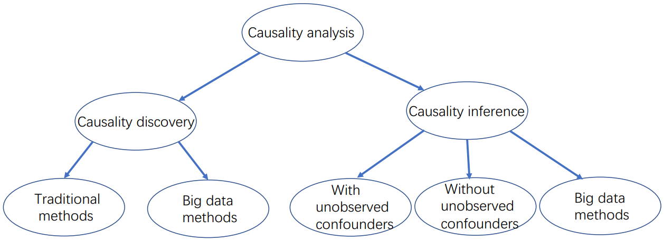
From Correlation to Causality
Causality analysis benefits
Enhance the interpretability of black box deep learning models
Help avoid unfair results
Improve the robustness of models
The taxonomy of causality analysis

Slide 44
Data Mining Methodologies and Systems
Structuring Unstructured Data for Knowledge Mining: A Data-Driven Approach
Data Augmentation
From Correlation to Causality
Network as a Context
Auto-ML: Methods and Systems
Notes:
44

Slide 45
Network as a Context
Network of X
Each node represents an entity, a data set or a data mining model
Examples: Network of time series
The key idea for mining network of time series data
Model each time series by either traditional signal processing approaches or deep neural networks
Leverage the contextual network to regularize different time series models

Slide 46
Network as a Context
Network of X
Each node represents an entity, a data set or a data mining model
Examples: Network of networks
Each X (i.e., node) itself of the contextual network represents another domain-specific network
The main advantages of the network of networks model
Explicitly encodes the hierarchical structure
The contextual network provides additional regularization

Slide 47
Network as a Context
Network of X
Each node represents an entity, a data set or a data mining model
Examples: Network of data mining models
Each X itself is a data mining model
Different performance prediction models ‘borrow’ data from each other
Mutually boost each other’s prediction performance
Future directions
The contextual network construction
Can be applied to more applications, e.g., knowledge graphs, heterogeneous networks
Integrate other data mining problems, e.g., adversarial learning, fairness, explainable learning.

Slide 48
Data Mining Methodologies and Systems
Structuring Unstructured Data for Knowledge Mining: A Data-Driven Approach
Data Augmentation
From Correlation to Causality
Network as a Context
Auto-ML: Methods and Systems
Notes:
48

Slide 49
Auto-ML: Methods and Systems
Why do we need Auto-ML
Different data mining and machine learning models have been widely used
Different task has different settings
Building and training appropriates mining models for each task could be time consuming
Domain experts might not be familiar with the mining models
Auto-ML classification
Automated Feature Engineering (Auto-FE)
Automatically detects the most representative and informative features
Automated Model and Hyperparameter Tuning (Auto-MHT)
Automatically builds machine learning models and tunes the hyper-parameters

Slide 50
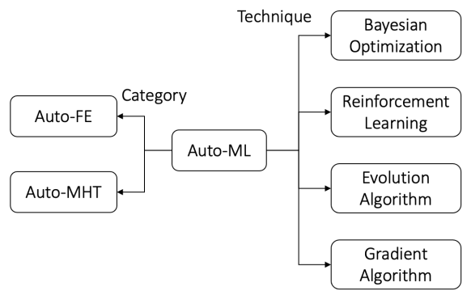
Auto-ML: Methods and Systems
Key challenges for Auto-ML
The lack of authoritative benchmarks for Auto-FE and Auto-MHT
The efficiency of Auto-ML
How to incorporate human knowledge or experiences into the AutoML to find suitable sub-space of the entire search space
The interpretability of Auto-ML
The scope of applications
Taxonomy of Auto-ML

Slide 51
Summary: Data Mining Methodologies and Systems
Structuring Unstructured Data for Knowledge Mining: A Data-Driven Approach
Transform unstructured text-rich data into organized, relatively structured data
Data Augmentation
We might be only provided by a limited number of labelled data
Data augmentation can prevent overfitting
From Correlation to Causality
Focus on the causality relation between observed variables

Slide 52
Summary: Data Mining Methodologies and Systems
Network as a Context
Provided a powerful context that links different types of data from different sources with different data mining algorithms
Auto-ML: Methods and Systems
Allow non-experts to make use of machine learning models and techniques without requiring them to become experts in machine learning.

Slide 53
Chapter 12. Data Mining Trends and Research Frontiers
Mining Rich Data Types
Data Mining Applications
Data Mining Methodologies and Systems
Data Mining, People and Society
Summary
Notes:
53

Slide 54
Data Mining, People and Society
Privacy-Preserving Data Mining
Human-Algorithm Interaction
Mining beyond Maximizing Accuracy: Fairness, Interpretability, and Robustness
Data Mining for Social Good
Summary
Notes:
54

Slide 55
Privacy-Preserving Data Mining
Privacy leakage between users and data owners
Example: re-identify users based on anonymous reviews on products.
Anonymize data for privacy protection
k-anonymity (P. Samarat et al., 1998): generalize the data so that it is identical to at least k-1 other records on the identifying attribute.
Differential privacy (A. Machanavajjhala et al. 2006)
Describe patterns of groups without sharing individual information.
Global sensitivity: for a function f and a pair of neighboring datasets D₁ and D₂, GS_{f} is the maximum difference between function value f(D₁) and f(D₂).

Slide 56
Privacy-Preserving Data Mining
Privacy leakage between data owners
Example: multiple companies collaboratively conduct data mining but refuse to share user information.
Solution: federated learning and analytics.
Federated learning
Run local computation over each data owners’ devices and aggregate results without leaking detailed data from individual data owners.
Example: federated K-Means.
Horizontal and vertical federated learning
Horizontal: data owned by each data owners follows the same schema.
Vertical: different data owners have the data on only some attributes/objects.

Slide 57
Data Mining, People and Society
Privacy-Preserving Data Mining
Human-Algorithm Interaction
Mining beyond Maximizing Accuracy: Fairness, Interpretability, and Robustness
Data Mining for Social Good
Notes:
57

Slide 58
Human-Algorithm Interaction
Human-algorithm interaction
Goal: optimize the collaboration between human intelligence and algorithm, and consequently enhance the system performance and user experience.
Crowdsourcing
Goal: harness the human intelligence to resolve difficult problems.
Applications: label generation, model evaluation, evaluating prediction interpretability, debug AI systems, etc.
Human-in-the-loop
Goal: leveraging human intervention for improving algorithms.
Applications: high-quality label generation for supervised learning, enhancing model explainability with background knowledge, model evaluation, etc.

Slide 59
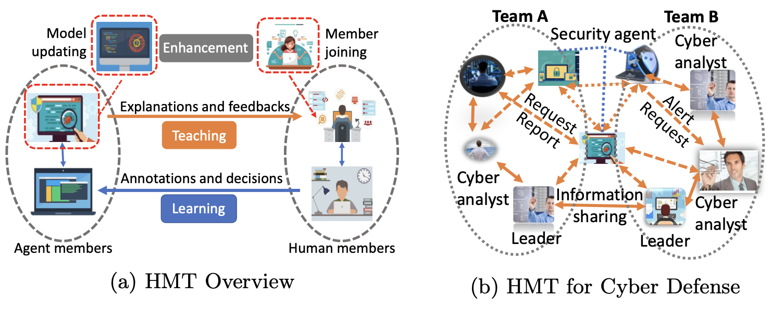
Human-Algorithm Interaction
Machine-in-the-loop
Goal: improving humans’ query strategy by algorithms.
Applications: creative writing and drawing, achieving comparable model performance which reducing the demand for labelled data
Human-machine-teaming
Goal: fostering the effective teamwork between humans and algorithms.
Applications:

Slide 60
Data Mining, People and Society
Privacy-Preserving Data Mining
Human-Algorithm Interaction
Mining beyond Maximizing Accuracy: Fairness, Interpretability, and Robustness
Data Mining for Social Good
Notes:
60

Slide 61
Mining beyond Maximizing Accuracy:
Fairness, Interpretability, and Robustness
Algorithm fairness: definitions
Group fairness
Demographic parity: predictions are independent of sensitive attributes
Equalized odds: conditional probability of the same prediction results given the label should be equal for different sensitive attributes.
Predictive rate parity: conditional probability of label given the prediction results should be equal for different sensitive attributes.
Individual fairness: preserve individual similarities, i.e., similar individuals should be treated similarly.
Counterfactual fairness: correct predictions of a label variable that are unfairly altered by an individual’s sensitive attribute.

Slide 62
Mining beyond Maximizing Accuracy:
Fairness, Interpretability, and Robustness
Algorithm fairness: strategies
Pre-processing
Learn representations that removes the impact of sensitive attributes.
Optimization at training
Use regularizers or constraints to achieve trade-off between mitigating the bias and retaining the original mining accuracy.
Post-processing
Find a proper threshold for each group to achieve certain types of fairness

Slide 63
Mining beyond Maximizing Accuracy:
Fairness, Interpretability, and Robustness
Interpretability
Goal: explain results given by ‘black boxes’.
Visualize summary statistics for each feature as interpretation.
Explore self-interpretable components of the models (e.g., weights in the linear model, structure of decision trees)
Identifying key data points for interpretation.
Robustness
Goal: ensuring consistency between test results and training results with unintentionally added noises or intentional adversarial attacks.
Reactive methods: detect adversarial examples after the model is built.
Proactive methods: make mining models more robust to attacks

Slide 64
Data Mining, People and Society
Privacy-Preserving Data Mining
Human-Algorithm Interaction
Mining beyond Maximizing Accuracy: Fairness, Interpretability, and Robustness
Data Mining for Social Good
Notes:
64

Slide 65
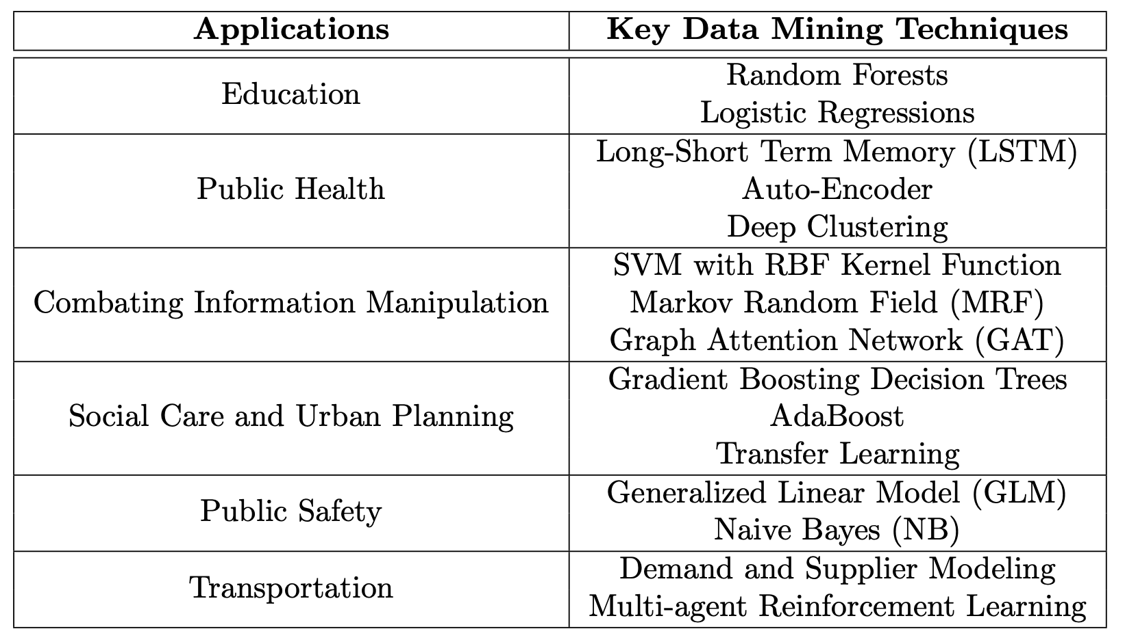
Data Mining for Social Good
Data mining applications
Challenges
Data scarcity: lack of large-scale data
Evaluation: standard evaluation metrics may be insufficient in real-world scenarios
Human-in-the-loop: insufficient use of domain knowledge from experts
Sustainable deployment

Slide 66
Summary: Data Mining, People and Society
Privacy-Preserving Data Mining
Privacy between user and data owner: differential privacy
Privacy between data owners: federated learning
Human-Algorithm Interaction
Crowdsourcing
Human-in-the-Loop
Machine-in-the-Loop
Human-Machine-teaming
Beyond Accuracy
Fairness: group fairness, individual fairness, and counterfactual fairness
Interpretability
Robustness
Data Mining for Social Good

Slide 67
References
Pierangela Samarati and Latanya Sweeney. Protecting Privacy when Disclosing Information: k-Anonymity and its Enforcement through Generalization and Suppression. Technical report, SRI International, 1998.
A. Machanavajjhala, J. Gehrke, D. Kifer, and M. Venkitasubramaniam. L-diversity: privacy beyond k-anonymity. In Proc. 2006 Int. Conf. Data Engineering (ICDE’06), pages 24–24, Atlanta, GA, USA, Apr. 2006.
Vikas C. Raykar, Shipeng Yu, Linda H. Zhao, Gerardo Hermosillo Valadez, Charles Florin, Luca Bogoni, and Linda Moy. Learning from crowds. Journal of Machine Learning Research, 11(43):1297– 1322, 2010.

Slide 68
Chapter 12. Data Mining Trends and Research Frontiers
Mining Rich Data Types
Data Mining Applications
Data Mining Methodologies and Systems
Data Mining, People and Society
Summary
Notes:
68

Slide 69
Summary: Data Mining Trends and Research Frontiers
Mining Rich Data Types
Text data
Spatial-Temporal data
Graph and Networks
Data Mining Methodologies and Systems
Structure Unstructured Data for Knowledge Mining
Data Augmentation
From Correlation to Causality
Network as a Context
Auto-ML

Slide 70
Summary: Data Mining Trends and Research Frontiers
Data Mining Applications
Data Mining for Sentiment and Opinion
Truth Discovery and Misinformation Identification
Information and Disease Propagation
Productivity and Team Science
Data Mining, People and Society
Privacy-Preserving Data Mining
Human-Algorithm Interaction
Mining beyond Maximizing Accuracy: Fairness, Interpretability, and Robustness
Data Mining for Social Good

Slide 71
References (Mining Rich Data Types)
T. Mikolov, I. Sutskever, K. Chen, G. S. Corrado, and J. Dean. Distributed representations of words and phrases and their compositionality. NIPS'13
J. Pennington, R. Socher, and C. D. Manning. GloVe: Global vectors for word representation. EMNLP'14
Y. Meng, J. Huang, G. Wang, C. Zhang, H. Zhuang, L. M. Kaplan, and J. Han. Spherical text embedding. NeurIPS'19
M. Nickel and D. Kiela. Poincaré embeddings for learning hierarchical representations. NIPS’17
J. Devlin, M.-W. Chang, K. Lee, and K. Toutanova. BERT: Pre-training of deep bidirectional transformers for language understanding. NAACL-HLT'19

Slide 72
References (Mining Rich Data Types)
G. Atluri, A. Karpatne, and V. Kumar. Spatiotemporal data mining: A survey of problems and methods. ACM Comput. Surv., August 2018
S. Shekhar, R. Vatsavai, and M. Celik. Spatial and spatiotemporal data mining: Recent advances. Next Generation of Data Mining, 2008.
P. W. Holland, K. B. Laskey, and S. Leinhardt. Stochastic blockmodels: First steps. Social networks, 5, 1983.
J. Leskovec, D. Chakrabarti, J. Kleinberg, C. Faloutsos, and Z. Ghahramani. Kronecker graphs: an approach to modeling networks. JMLR, 11, 2010.
Y. Dong, N. V. Chawla, and A. Swami. metapath2vec: Scalable representation learning for heterogeneous networks. KDD’17

Slide 73
References (Data Mining Methodologies and Systems)
J. G. Shanahan, Y. Qu, and J. Wiebe, editors. Computing Attitude and Affect in Text: Theory and Applications. Springer, 2006.
B. Liu. Sentiment Analysis: Mining Opinions, Sentiments, and Emotions. Cambridge University Press, 2020.
Y. Li, J. Gao, C.i Meng, Q. Li, L. Su, B. Zhao, W. Fan, and J. Han. A survey on truth discovery. SIGKDD, 2015.
L. Wu, F. Morstatter, K. M. Carley, and H. Liu. Misinformation in social media: Definition, manipulation, and detection. SIGKDD’19.
Z. Chen, H. Tong, and L. Ying. Inferring full diffusion history from partial timestamps. TKDE’19.

Slide 74
References References (Data Mining Methodologies and Systems)
Y. Yang and J. Pei. Influence analysis in evolving networks: A survey. TKDE’19.
S. F Ardabili, A. Mosavi, P. Ghamisi, F. Ferdinand, A. R Varkonyi-Koczy, U. Reuter, T. Rabczuk, and P. M Atkinson. Covid-19 outbreak prediction with machine learning. Algorithms, 2020.
J. Hackman and N. Katz. Group Behavior and Performance, 2010.
L. Li and H. Tong. Computational Approaches to the Network Science of Teams. Cambridge University Press, 2020.

Slide 75
References (Data Mining Applications)
Jingbo Shang, Jialu Liu, Meng Jiang, X. Ren, Clare R. Voss, and Jiawei Han. Automated phrase mining from massive text corpora. IEEE Transactions on Knowledge and Data Engineering, 2018.
Chi Wang and Jiawei Han. Mining Latent Entity Structures. Morgan & Claypool, 2015.
Xiang Ren, Ahmed El-Kishky, Chi Wang, Fangbo Tao, Clare R. Voss, Heng Ji, and Jiawei Han. ClusType: Effective entity recognition and typing by relation phrase-based clustering. KDD, 2015.
Jiaxin Huang, Yiqing Xie, Yu Meng, Jiaming Shen, Yunyi Zhang, and Jiawei Han. Guiding corpus-based set expansion by auxiliary sets generation and co-expansion. The Web Conf. (WWW’20), 2020.

Slide 76
References (Data Mining Applications)
Ekin Dogus Cubuk, Barret Zoph, Dandelion Man´e, Vijay Vasudevan, and Quoc V. Le. Autoaugment: Learning augmentation policies from data. CoRR, 2018.
Siyu Shao, Pu Wang, and Ruqiang Yan. Generative adversarial networks for data augmentation in machine fault diagnosis. Comput, 2019.
Antreas Antoniou, Amos J. Storkey, and Harrison Edwards. Data augmentation generative adversarial networks. CoRR, 2017.
Peter Spirtes, Clark N Glymour, Richard Scheines, and David Heckerman. Causation, prediction, and search. MIT press, 2000.
David Maxwell Chickering. Optimal structure identification with greedy search. Journal of machine learning research, 2002.

Slide 77
References (Data Mining Applications)
Keisuke Hirano, Guido W Imbens, and Geert Ridder. Efficient estimation of average treatment effects using the estimated propensity score. Econometrica, 2003.
Christos Louizos, Uri Shalit, Joris Mooij, David Sontag, Richard Zemel, and Max Welling. Causal effect inference with deep latent variable models. arXiv, 2017.
Yongjie Cai, Hanghang Tong, Wei Fan, and Ping Ji. Fast mining of a network of coevolving time series. In Proc. 2015 SIAM Int. Conf. Data Mining (SDM’15), 2015.
Yongjie Cai, Hanghang Tong, Wei Fan, Ping Ji, and Qing He. Facets: Fast comprehensive mining of coevolving high-order time series. KDD, 2015.

Slide 78
References (Data Mining, People and Society)
Hannes Heikinheimo and Antti Ukkonen. The crowd-median algorithm. In Proc. 2013 Conf. Human Computation and Crowdsourcing (HCOMP’13), Palm Springs, CA, USA, Nov. 2013.
Flavio P Calmon, Dennis Wei, Bhanukiran Vinzamuri, Karthikeyan Natesan Ramamurthy, and Kush R Varshney. Optimized pre-processing for discrimination prevention. In Proc. 2017 Conf. Neural Information Processing Systems (NIP’17), pages 3995–4004, Long Beach, CA, USA, Dec. 2017.
Kui Ren, Tianhang Zheng, Zhan Qin, and Xue Liu. Adversarial attacks and defenses in deep learning. Engineering, 6(3):346–360, 2020.
Christoph Molnar. Interpretable machine learning. Lulu. com, 2020.

Slide 79
References (Data Mining, People and Society)
Wojciech Samek, Thomas Wiegand, and Klaus-Robert Mu ̈ller. Explainable artificial intelligence: Understanding, visualizing and interpreting deep learning models. arXiv preprint arXiv:1708.08296, 2017.
Jacob Abernethy, Alex Chojnacki, Arya Farahi, Eric Schwartz, and Jared Webb. Activeremediation: The search for lead pipes in flint, michigan. In Proc. 2018 ACM SIGKDD Int. Conf. Knowledge Discovery and Data Mining (KDD’18), pages 5–14, London, UK, Aug. 2018.
Kaixiang Lin, Renyu Zhao, Zhe Xu, and Jiayu Zhou. Efficient large-scale fleet management via multi-agent deep reinforcement learning. In Proc. 2018 ACM SIGKDD Int. Conf. Knowledge Discovery and Data Mining (KDD’18), pages 1774–1783, London, UK, Aug. 2018.

